Slide 1
DNA Replication, Transcription and Translation
Dr. Michael Frimpong
Senior Lecturer, Department of Molecular Medicine

Slide 2
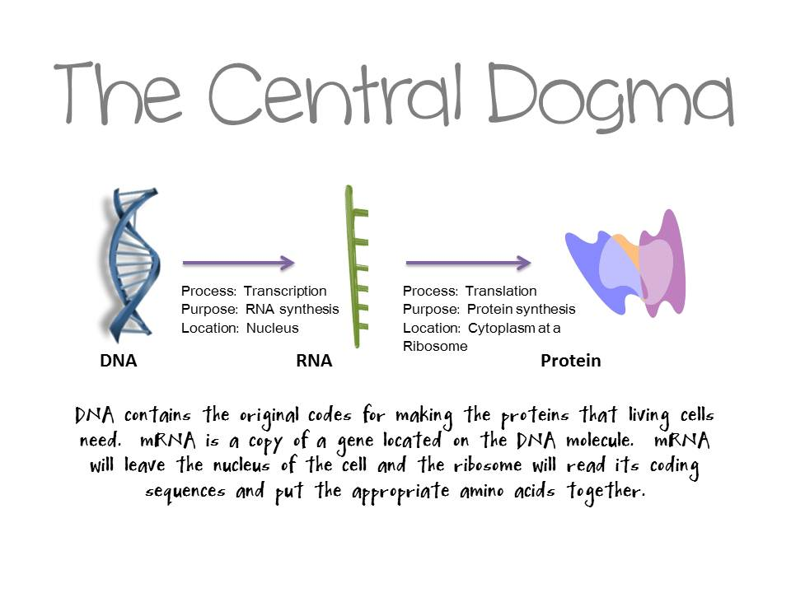
Essential idea:
Genetic information in DNA can be accurately copied and can be translated to make the proteins needed by the cell.

Slide 3
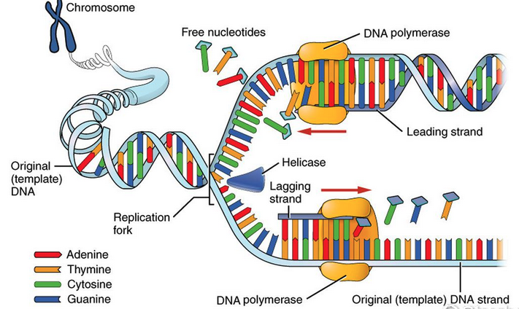
DNA Replication Overview
DNA replication is semi-conservative and depends on complementary base pairing.
Helicase unwinds the double helix and separates the two strands by breaking hydrogen bonds.
DNA polymerase links nucleotides together to form a new strand, using the pre-existing strand as a template.
Notes:
DNA replication is semi-conservative because each new DNA molecule consists of one original (parental) strand and one newly synthesized strand.

Slide 4
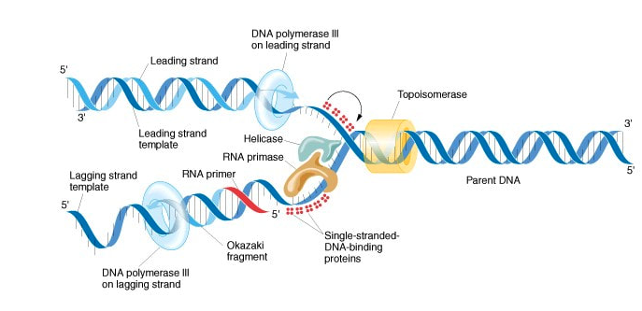
Steps in DNA Replication
Begins at a specific sequence of nucleotides (Origins of replication)
Helicase
Breaks hydrogen bonds between paired bases.
Unwinds parent DNA strand.
Single-strand binding proteins keep the strands apart.

Slide 5
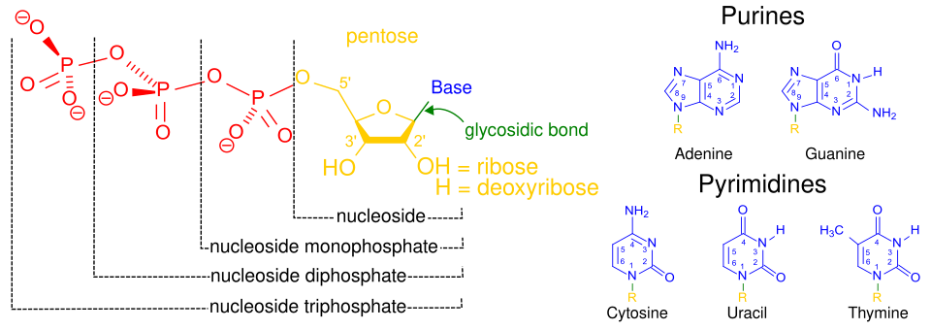
Steps in DNA Replication
RNA primer
Must be bound to DNA segment to begin replication
Short segments of RNA (10 nucleotides long) formed by primase.
Free nucleotides (Nucleoside triphosphates) bind with complementary bases on unzipped portions of DNA.
New strands grow in the 5’ to 3’ direction
3’ end contains hydroxyl
5’ end contains phosphate
Process is catalyzed by DNA polymerase.

Slide 6
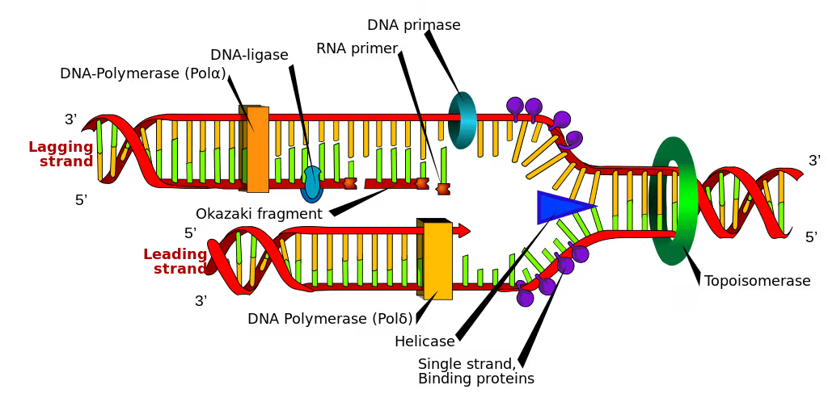
Steps in DNA Replication
DNA Polymerase can only elongate at 3’ end.
Continuous synthesis creates a leading strand.
Discontinuous synthesis of the complementary strand creates a lagging strand.
Lagging strand produces Okazaki fragments.
Fragments are linked by DNA ligase.

Slide 7
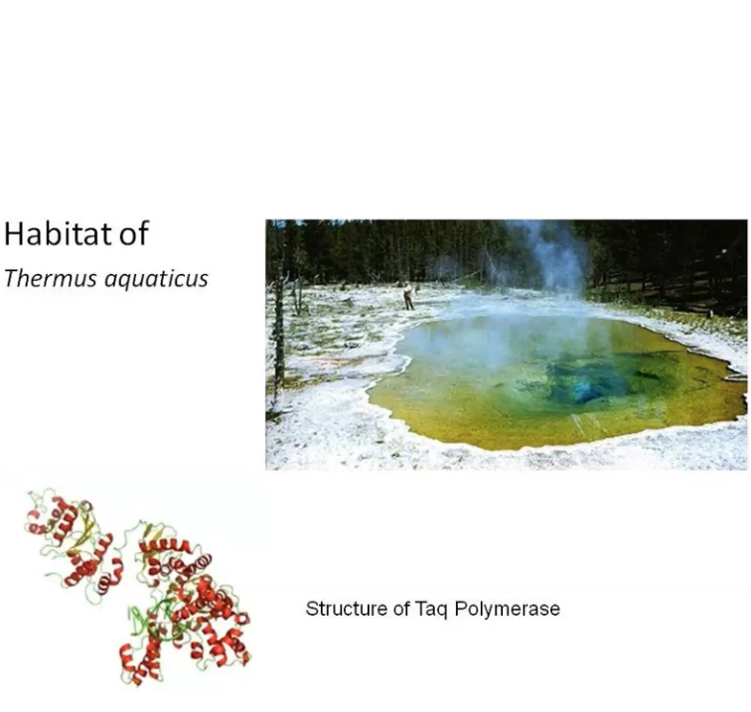
Polymerase Chain Reaction (PCR)
Uses Taq polymerase
A thermostable DNA polymerase named after the thermophile bacterium Thermus aquaticus
Produces large quantities of a specific target sequence of DNA.
It is useful when only a small amount of DNA is available for testing.

Slide 8
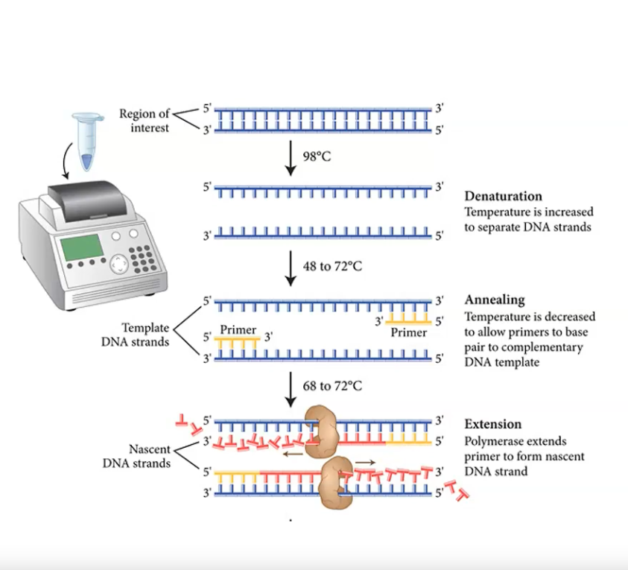
Polymerase Chain Reaction (PCR)
Occurs in a thermal cycler and involves a repeat procedure of 3 steps.
Denaturation: DNA sample is heated to separate it into two strands
Annealing: DNA primers attach to opposite ends of the target sequence
Elongation: A heat-tolerant DNA polymerase (Taq) copies the strands

Slide 9
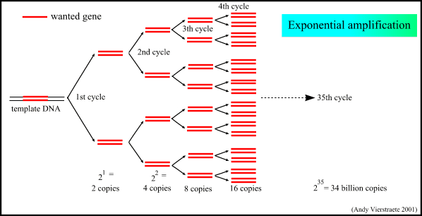
Polymerase Chain Reaction (PCR)
One cycle of PCR yields two identical copies of the DNA sequence.
A standard reaction of 30 cycles would yield 1,073,741,826 (2³⁰) copies of DNA

Slide 10
Transcription

Slide 11
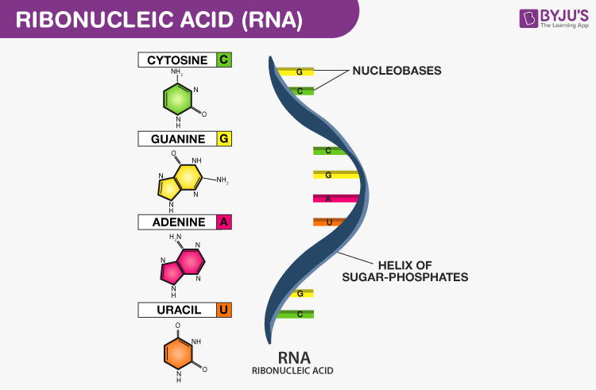
Ribonucleic Acid (RNA)
RNA is a single-stranded nucleic acid molecule and is made up of ribonucleotides
A ribose nucleotide in the chain of RNA consists of a ribose sugar, a phosphate group, and a base
In each ribose sugar, one of the four bases is added: Adenine (A), Guanine (G), Cytosine (C), and Uracil (U)
The base is attached to a ribose sugar with the help of a phosphodiester bond

Slide 12
Functions of RNA
Messenger RNA (mRNA) carries a message from DNA in the nucleus to ribosomes in the cytoplasm.
Ribosomal RNA (rRNA) and proteins make up ribosomes, where proteins are synthesized.
Transfer RNA (tRNA) transports amino acids to the ribosomes during protein synthesis.
RNA interference (RNAi)
Regulation of gene expression at the level of mRNA transcription.
Includes miRNA (micro) and siRNA (small interfering).

Slide 13
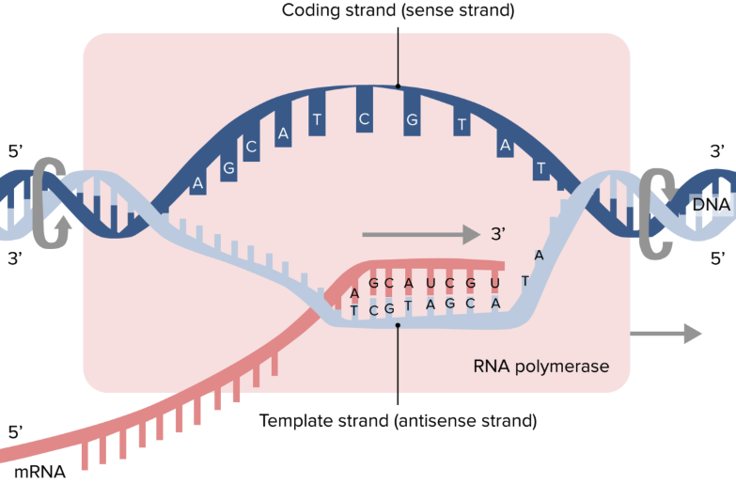
Transcription Overview
Transcription is the synthesis of mRNA copied from the DNA base sequences by RNA polymerase.
Takes place in the nucleus.
Only one strand of DNA is copied
After transcription, the DNA strands rejoin
Notes:
- Transcription – the synthesis of RNA, using DNA as a template, because RNA is a single-stranded, transcription only occurs along one of the two strands of DNA

Slide 14
Steps in Transcription
DNA unwinds.
RNA polymerase recognizes a specific DNA sequence called a promoter and binds to it.
The promoter identifies the start of a gene, which strand is to be copied, and the direction that it is to be copied.
Complementary bases are assembled (U instead of T).
A termination code in the DNA indicates where transcription will stop.
The mRNA produced is called a mRNA transcript.

Slide 15
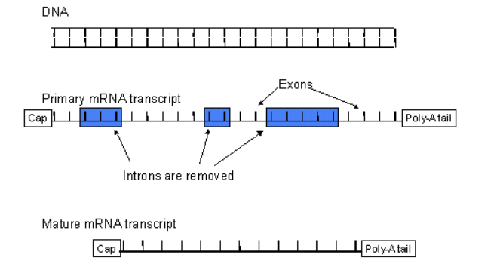
Post-Transcription Modification
A cap is added to the 5’ end (GTP cap – modified guanine)
A poly-A tail (150 to 200 Adenines) is added to the 3’ end of the molecule.
The newly-formed mRNA has regions that do not contain a genetic message (introns) that must be removed.
The remaining portions of mRNA are called exons. They are spliced together to form a mature mRNA transcript.
Notes:
In eukaryotic cells, the newly-formed mRNA transcript (also called heterogenous nuclear RNA or hnRNA) must be further modified before it can be used.
The newly-formed mRNA has regions that do not contain a genetic message.

Slide 16
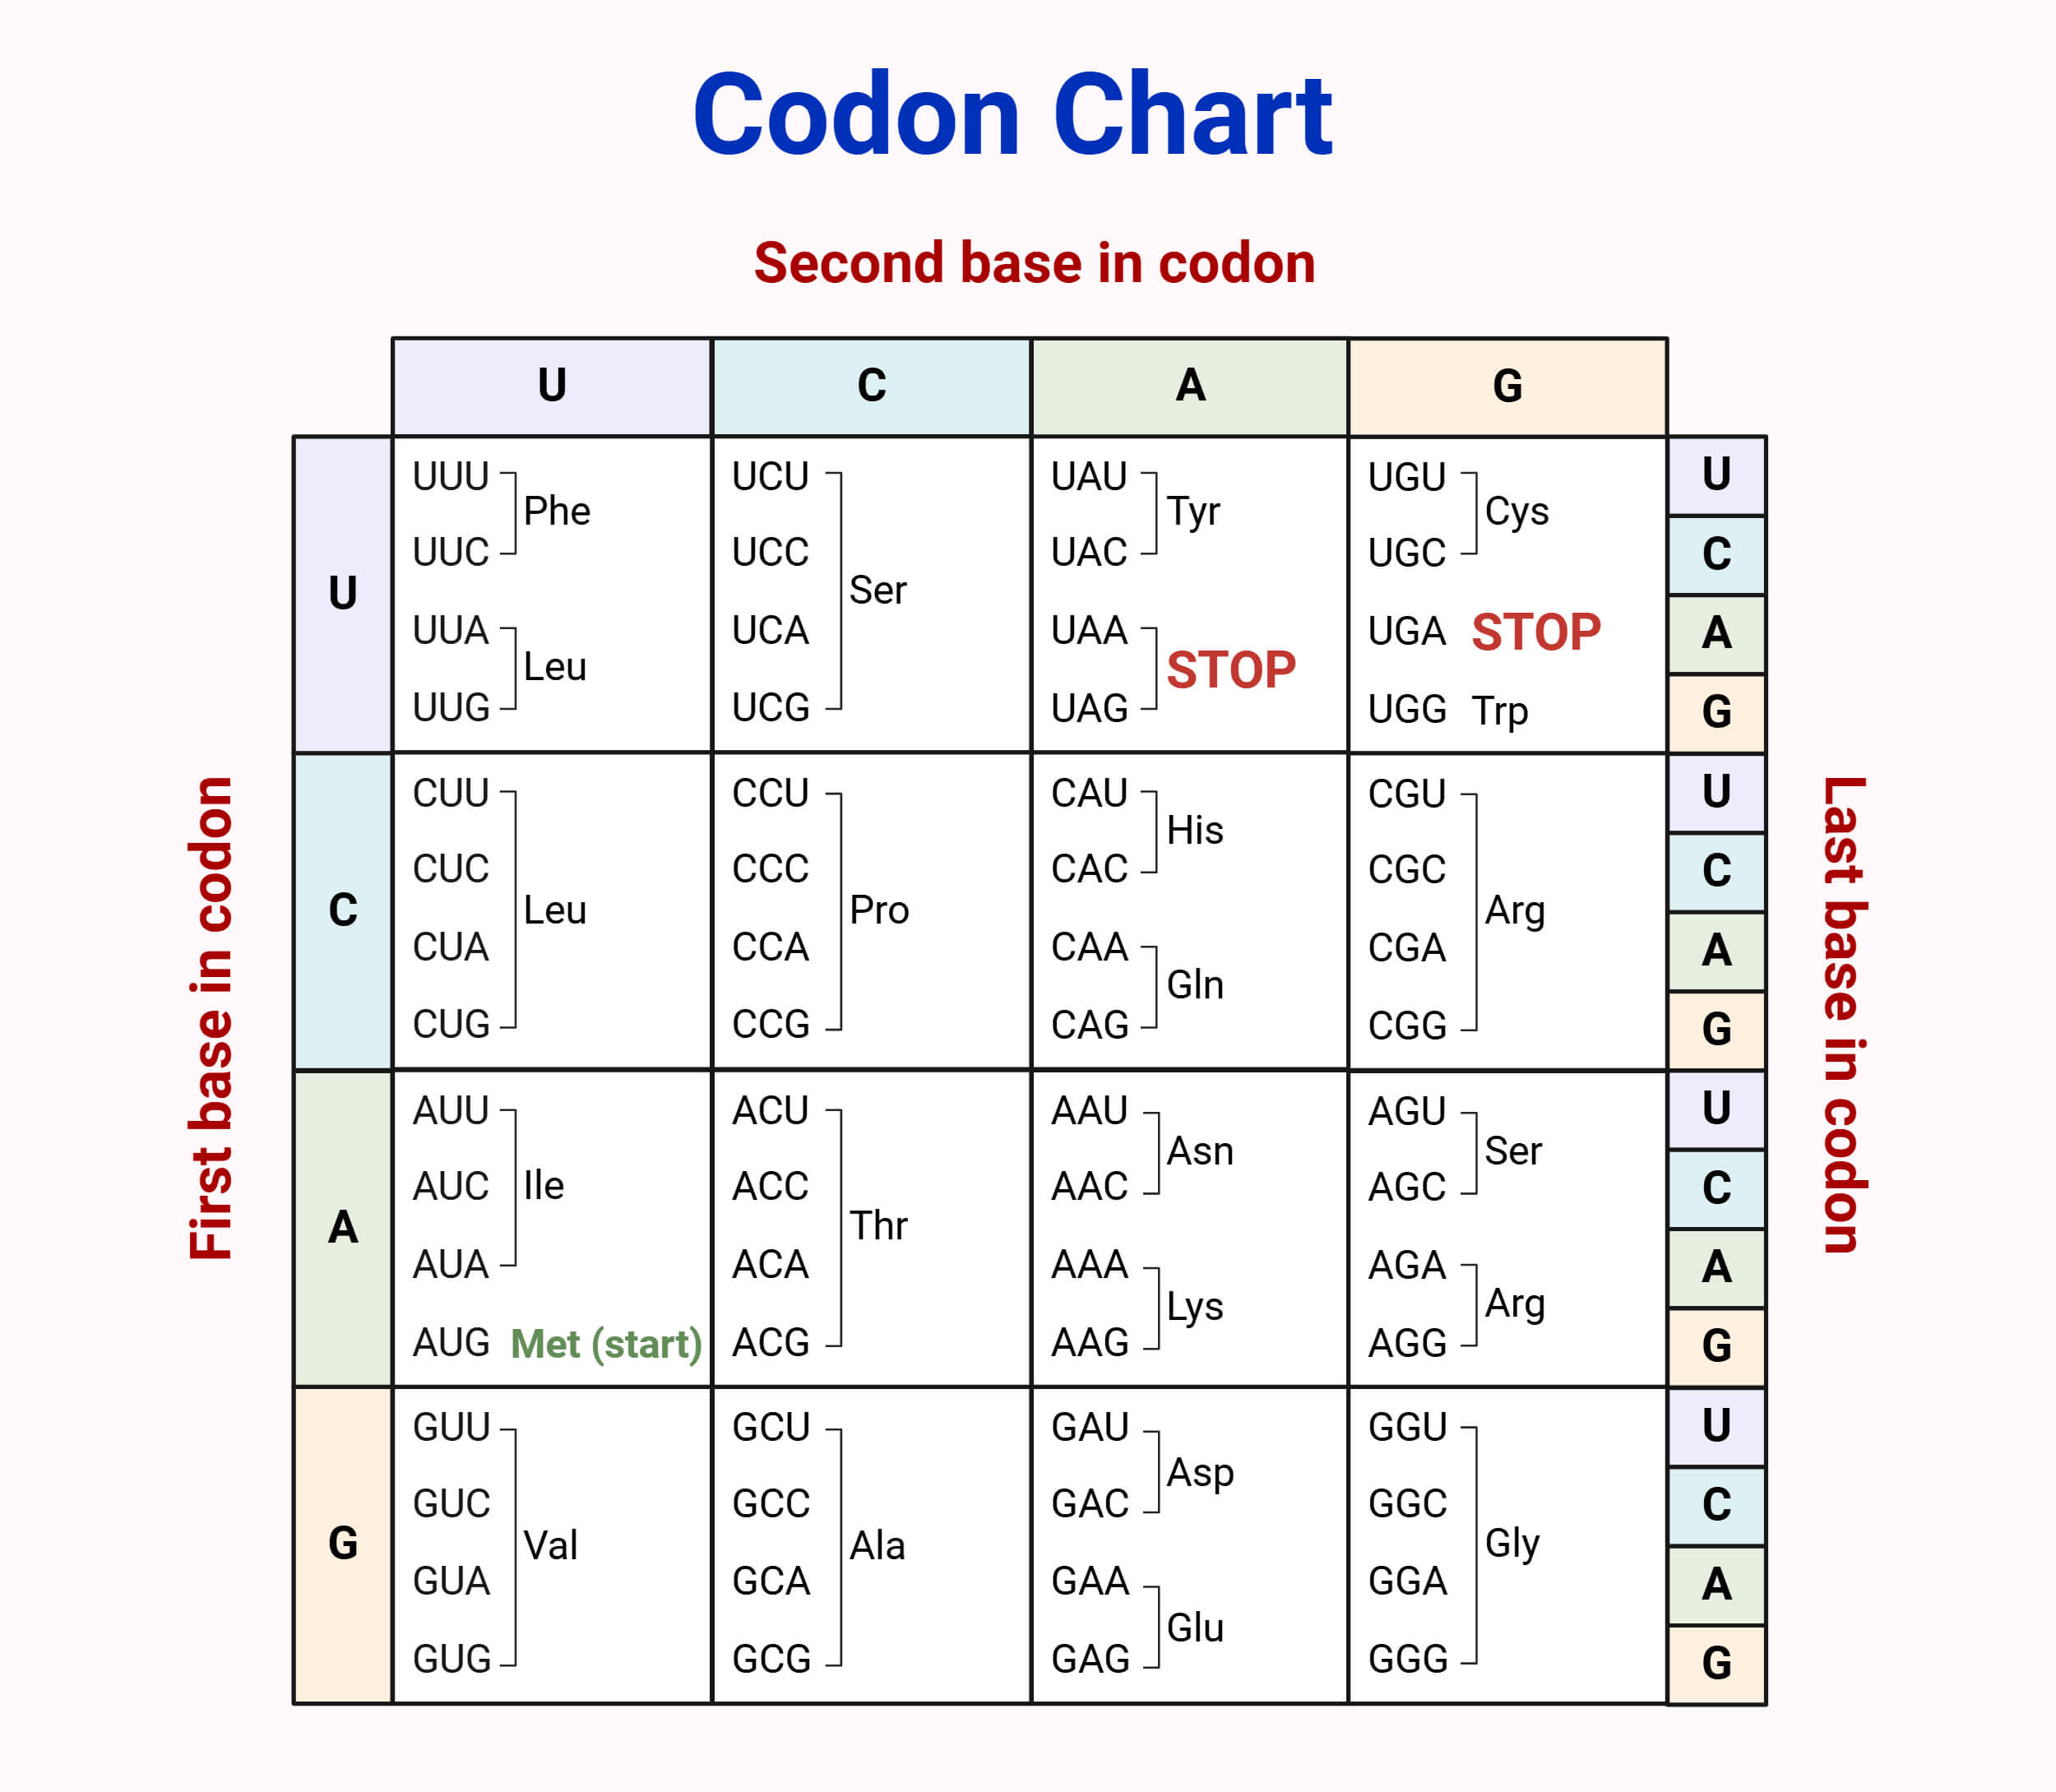
The Genetic Code
Codons are three sequential bases on mRNA corresponding to one amino acid in a polypeptide.
mRNA triplets (codons) are the genetic code.
64 codons (4³ – 64) code for 20 amino acids, one start codon, and 3 stop codons.

Slide 17
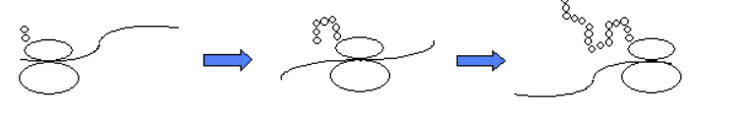
Translation
Translation is the process where ribosomes synthesize proteins using the mature mRNA transcript.
Is the synthesis of polypeptides on ribosomes.
Translation depends on complementary base pairing between codons on mRNA and anticodons on tRNA.

Slide 18
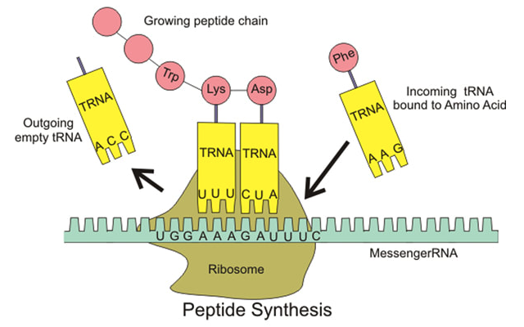
Steps in Translation
Ribosomes bind to mRNA in the cytoplasm and move along the molecule in a 5’ – 3’ direction until it reaches a start codon (AUG).
Anticodons on tRNA molecules align opposite appropriate codons according to complementary base pairing (e.g. AUG = UAC).
Each tRNA molecule carries a specific amino acid (according to the genetic code).
Ribosomes catalyse the formation of peptide bonds between adjacent amino acids

Slide 19
Steps in Translation
The ribosome moves along the mRNA molecule, synthesising a polypeptide chain until it reaches a stop codon.
Release factor protein binds to stop codon.
The polypeptide is enzymatically cleaved from the last tRNA.
At this point translation ceases and the polypeptide chain is released

Slide 20
Recombinant DNA Techniques

Slide 21
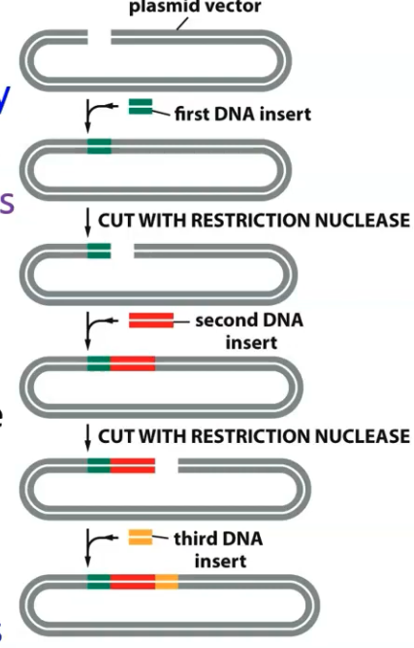
Constructing Novel DNA Molecules
Recombinant DNA molecules (i.e., DNA molecules/sequences that are not naturally occuring and artificially made in a lab) are often created by taking two different pieces of DNA and ‘gluing’ them together with LIGASE.
These can be from different organisms, be synthesized
With PCR, RE digestions, Cloning, etc.
Notes:
- This allows “custom-built” DNA wich may contained desired mutations.

Slide 22
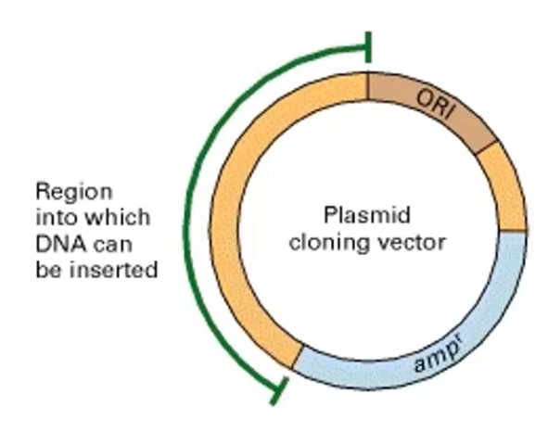
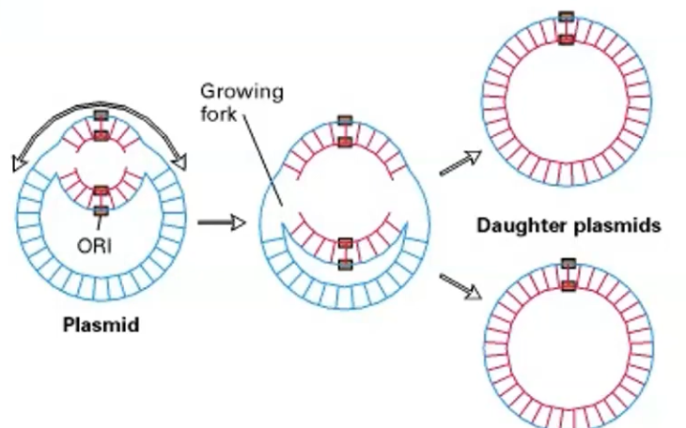
Overview of Plasmids/Vectors
Plasmids are circular double-stranded DNA Molecule
Notes:
ORI (origin of replication – the portion of the plasmid that allows the plasmid to be replicated in host cells.
Tracking marker – ampr – allows us to differentiate cells tha express the plasmids from those that do not.
Cloning sites have multiple restriction sites.

Slide 23
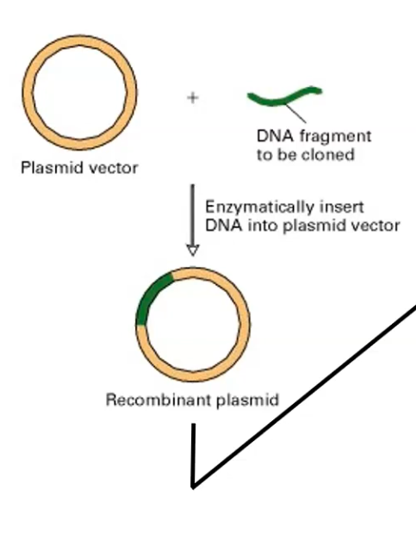
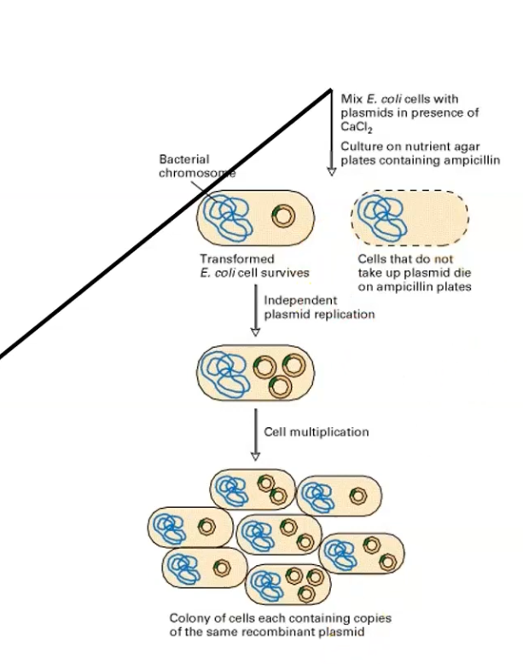
Overview of Cloning
Notes:
-

Slide 24
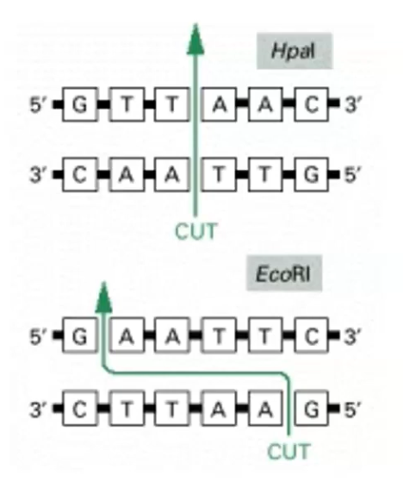
Restriction Enzymes
These are proteins that cut DNA molecules at specific nucleotide sequences.
Bind to specific sequence (6-mers)
Cut (Blunt or sticky end)
RE have palindromic sequences
RE create double strand breaks when they cut.
Notes:
The most common restriction enzymes binds to six-mers (6 base pairs of DNA).
Internal complementarity (palindrome)
Palindrome – is a word or phrase with letters that read the same backwards as forward (racecar)

Slide 25
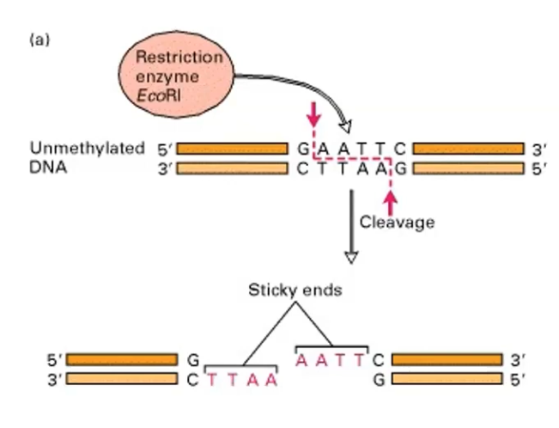
Restriction Enzymes
RE do not cut methylated DNA
In order to prevent bacterial cut genome in nature, restriction sites are methylated
Notes:
- Sticky ends are portions or single-stranded overhangs that are hungry for or are ready to base pair to their complementary base sequence.

Slide 26
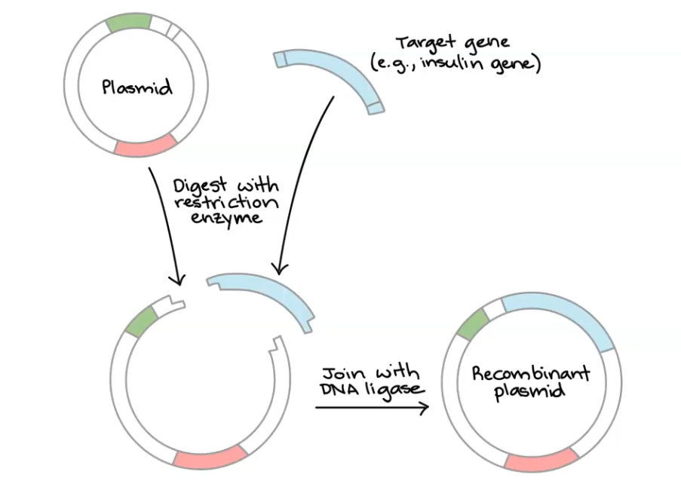
Cloning
https://www.youtube.com/watch?v=KRpik9mNRm0

Slide 27
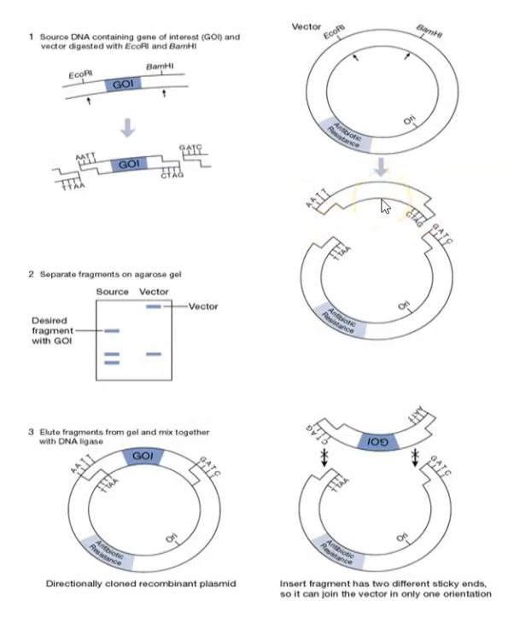
Cloning

Slide 28
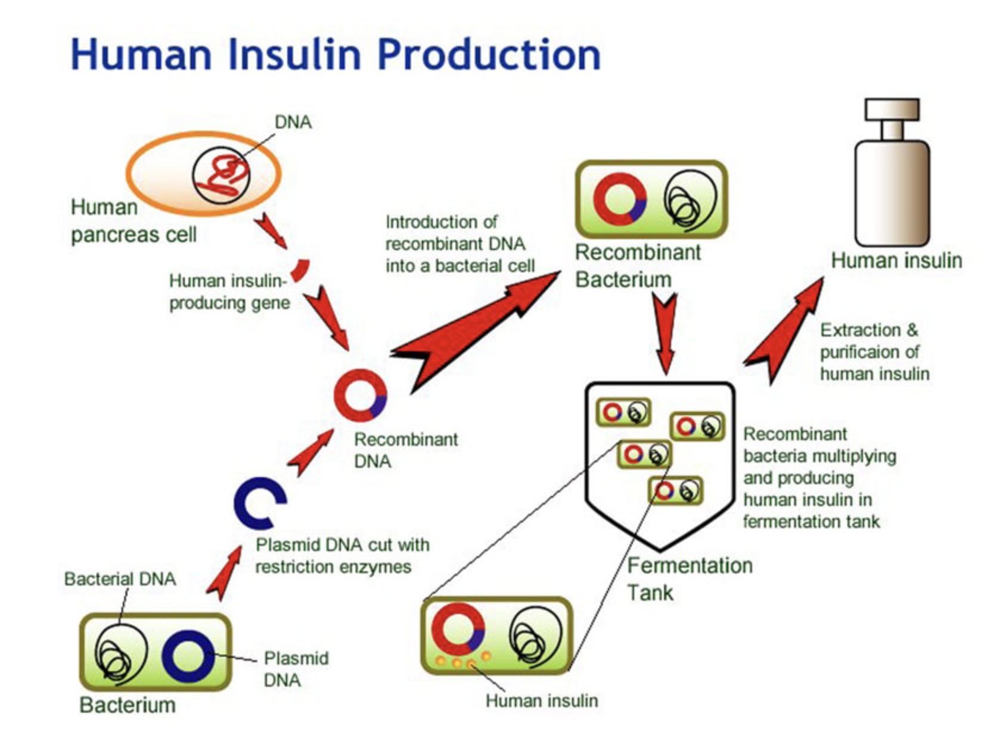
Recombinant DNA application
The gene responsible for insulin production is extracted from a human cell.
It is spliced into a plasmid vector before being inserted into a bacterial cell.
The transgenic bacteria (typically E. coli) are then selected and cultured in a fermentation tank.
The bacteria now produce human insulin, which is harvested, purified and packaged for human use (i.e. by diabetics).

Slide 29
Applications of Recombinant DNA
Disease Diagnosis: It aids in the diagnosis of genetic diseases and cancers by identifying specific DNA sequences associated with these conditions.
Gene therapy: This involves inserting new genes into a patient's cells to replace defective ones, potentially treating genetic disorders.
Vaccine Development: It is used to produce subunit vaccines, which contain specific parts of a pathogen's proteins, triggering an immune response without exposing individuals to the full pathogen.
Notes:
Gene therapy – first gene therapy in humans was conducted in the 1990 by researchers at NIH on a 4 year old with severe immunodeficiency caused by lack of adenosine deaminase (ADA).
She was transfused with her own blood engineered to contain a functional ADA.

